Slide 1

Smart Water Analytics Abhay, Dhruvi, Iustin, Kelsie & Rachael
Notes:
Abhay

Slide 2
1.
Background & Goal
Notes:
Dhruvi

Slide 3
Background
Acea Group is one of the leading Italian multi-utility operators
Manages and develops water and electricity networks and environmental services
Supplying 9 million inhabitants
Acea Group struggles with the need to forecast the water level in a waterbody
Notes:
Dhruvi

Slide 4
Goal
Issue to be addressed:
Water bodies need to be preserved to handle daily consumption
Important to predict the most efficient water availability
Create models to predict flow rate in the Madonna and Lupa spring
Notes:
Dhruvi

Slide 5
2.
Data Description
Notes:
Abhay

Slide 6
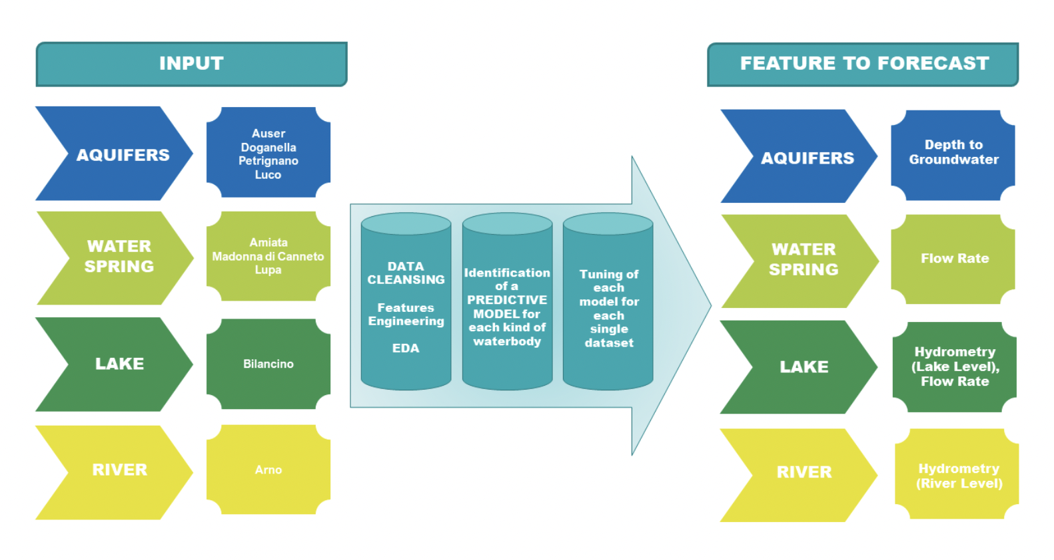
About the Data
3 water springs: Amiata, Lupa, & Madonna
Focusing on Madonna
Datasets are completely independent from each other
14,000+ observations across the 3 springs
Flow Rate is the feature to forecast
Notes:
Abhay

Slide 7
3.
Problems Faced & Steps Taken
Notes:
Abhay

Slide 8
Data Issues & Solutions
High prevalence of missing values
Dropped years with a high percentage of missing values
Imputed missing values using the Amelia package
External dataset was not in a compatible format
Preprocessing:
Transformed the date field to a date format
Split data into 80% training and 20% testing
Transformed both target variable and regressors to time series objects with a frequency of one
Notes:
Abhay

Slide 9
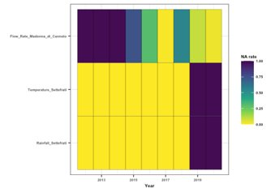
Madonna: Missing Values & Imputation
100% of values missing for flow rate for Madonna in years 2012, 2013, and 2014
100% of values missing for temperature and rainfall for Madonna in years 2019 and 2020
Applying imputation is not suitable -> exclude these two years from the dataset
Notes:
Kelsie

Slide 10
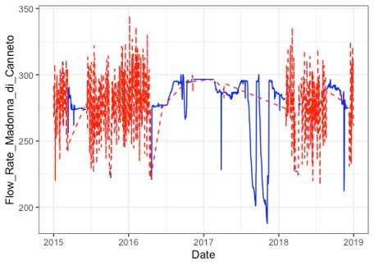
Madonna: Missing Values & Imputation
The graph illustrates the data before and after the missing data was imputed
The blue line represents the original flow rate values; the red line shows the imputed flow rate values
Notes:
Kelsie

Slide 11
4.
Method, Results, & Out of Sample Analysis
Autoregressive Integrated Moving Average (ARIMA)
Notes:
Dhruvi

Slide 12
What is ARIMA?
ARIMA is a time-series forecasting model
Auto Regressive (AR): Uses lag values to forecast
Integrated (I): Differencing steps required to make stationary
Moving Average (MA): Uses lagged forecast errors to forecast
Non seasonal ARIMA model is classified as an "ARIMA (p,d,q)" model
P: Number of autoregressive terms
D: Number of non-seasonal differences needed for stationarity
Q: number of lagged forecast errors in the prediction equation
Notes:
Dhruvi
ARIMA is a time series forecasting model which will be used to predict the water flow rates in the future. ARIMA stands for auto regression integrated moving average. It is class of models that forecasts using own past values including lag values and lagged forecast errors. Auto Regressive is used for lag values to forecast where the dependent variable depends on past values of itself, integrated is the differencing steps required to make stationary so instead of predicting the time series itself we will predict the differences of the series, and Moving average uses lagged forecast errors to forecast results and the model works by analyzing how wrong you were in predicting values for previous time periods to make a better estimate for current time period. Time series data is considered stationary if it contains constant mean, constant variance, covariance that is independent of time.
ARIMA consists of three parameters, p,q,d. P is the number of autoregressive terms so number of lags of Y used as predictors, D is number of non seasonal differences needed for stationarity, Q is number of lagged forecast errors.

Slide 13
Madonna: Preliminary ARIMA Model
Originally, our RMSE was very high
~15 for training and ~22 for testing in both univariate and multivariate ARIMA
To combat this issue and increase accuracy, we chose a smaller time horizon to predict
90 days
We will also look at seasonality of the data
Notes:
Rachael

Slide 14
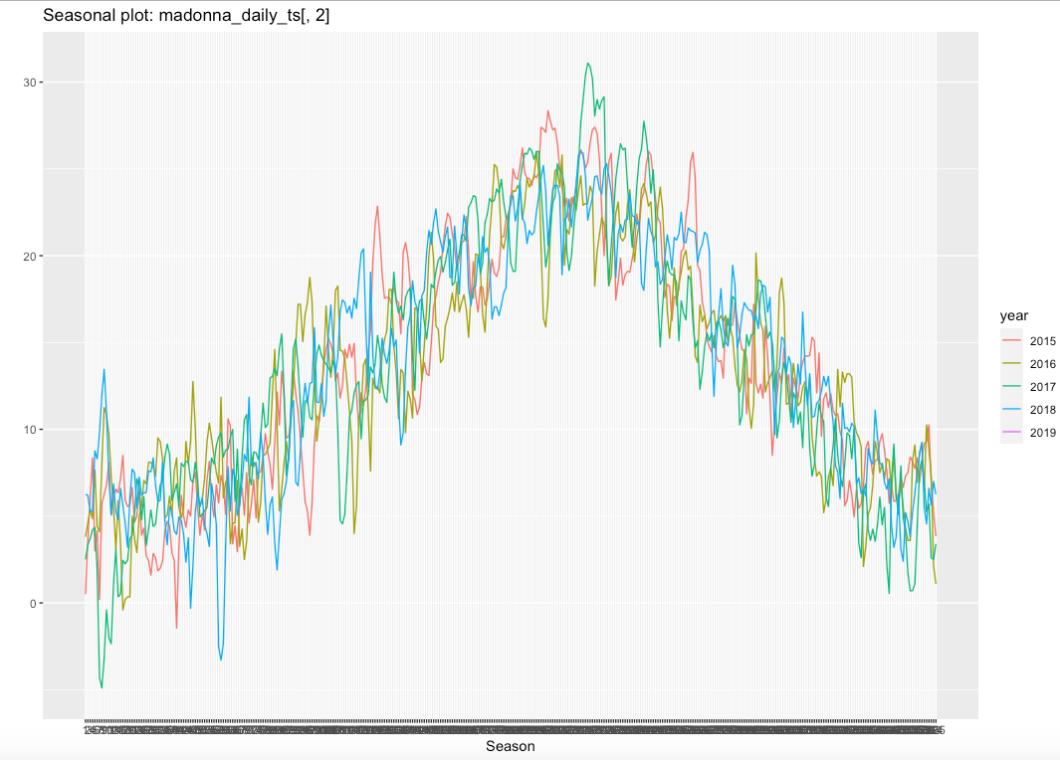
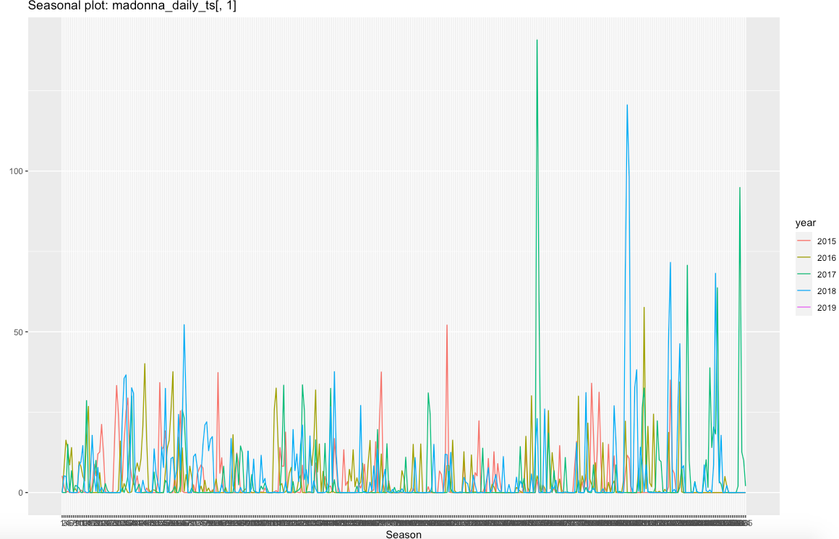
Seasonality of Temperature and Rainfall
(Left) Plotting temperature against seasons in different years, seasonality is seen for temperature
(Right) We do not observe as much seasonality with rainfall
Notes:
Rachael

Slide 15
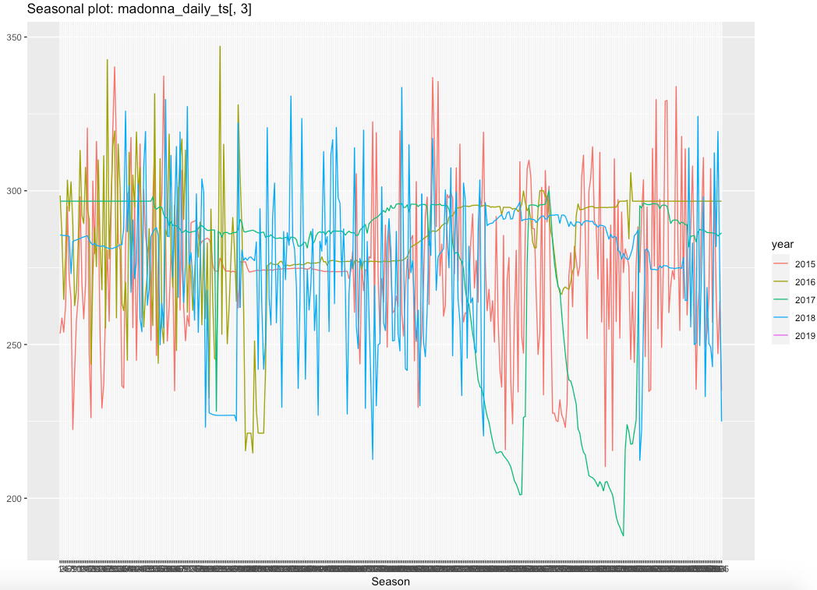
Seasonality of Flow Rate
However, when looking at our outcome variable (flow rate), there is no trend that each year follows
Seasonality not carrying over between our regressors and target variable is likely what leads to similar results for univariate and multivariate ARIMA models
Notes:
Rachael

Slide 16
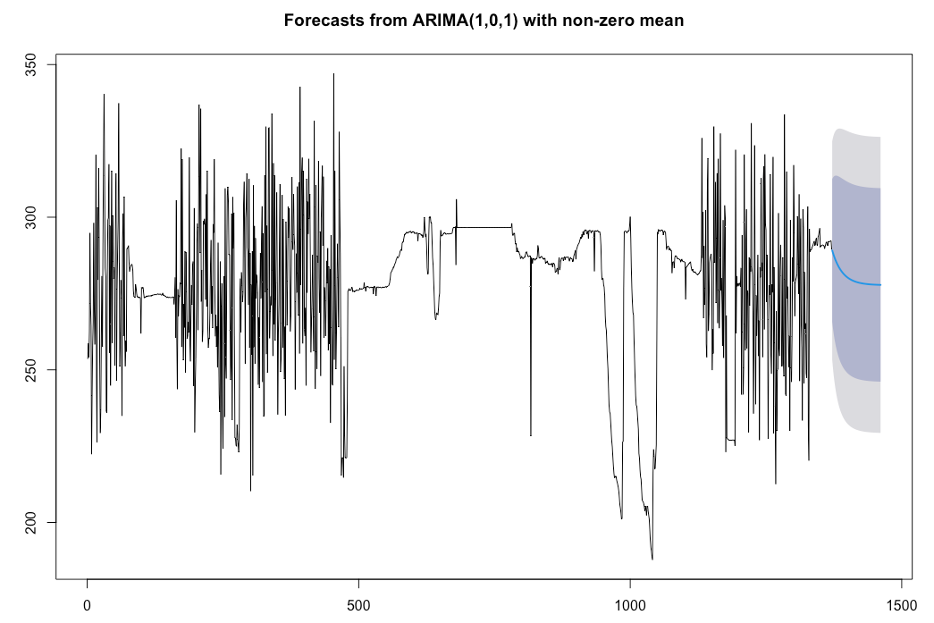
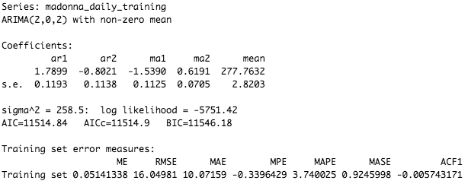

Madonna: Univariate ARIMA (Daily)
Notes:
Rachael

Slide 17
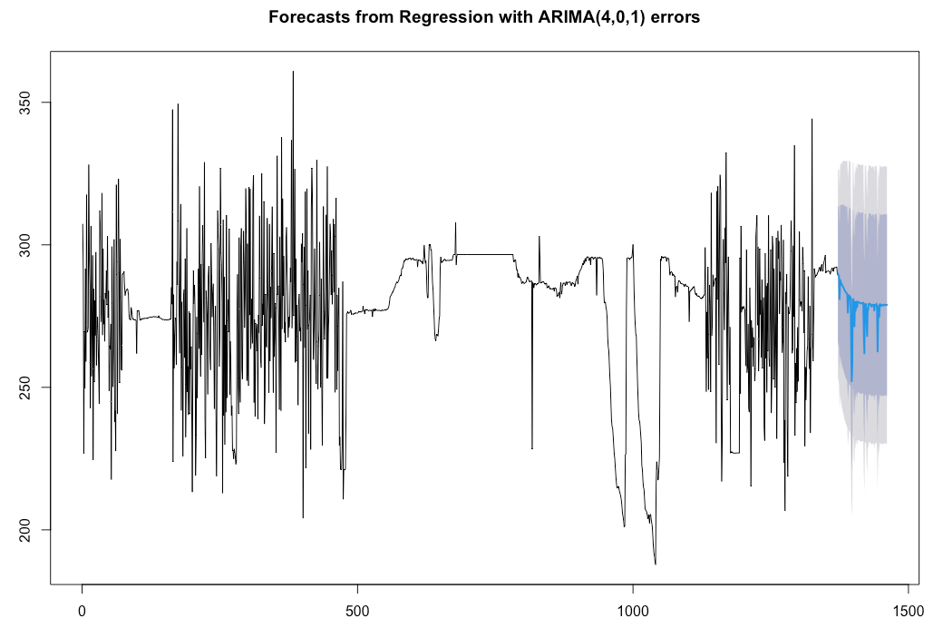
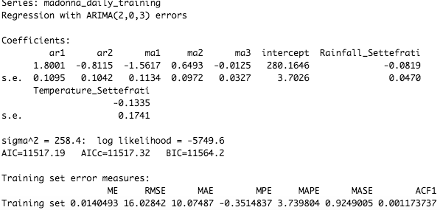

Madonna: Multivariate ARIMA (Daily)
Notes:
Rachael

Slide 18
Observations for Daily ARIMA
Multivariate ARIMA had a slightly better RMSE in the training set compared to Univariate ARIMA, but they are extremely similar
The univariate ARIMA model had a better RMSE for out of sample data
Notes:
Rachael

Slide 19
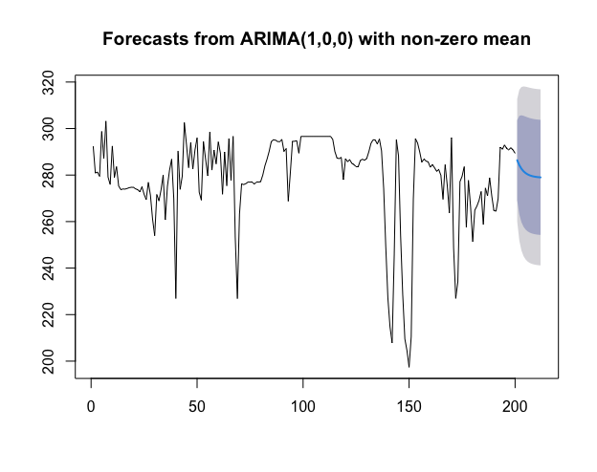
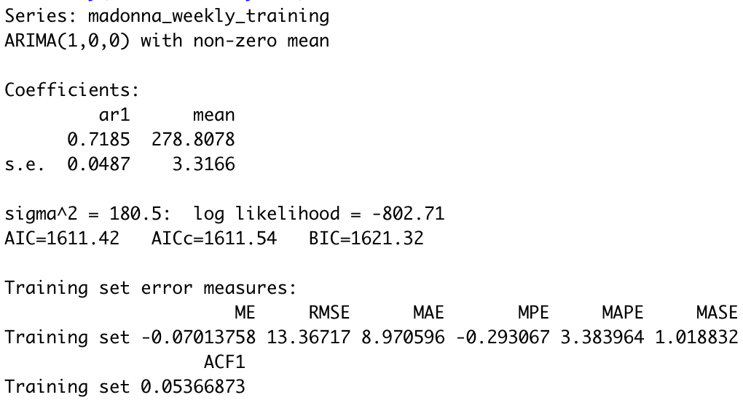

Madonna: Univariate ARIMA (Weekly)
Notes:
Kelsie

Slide 20
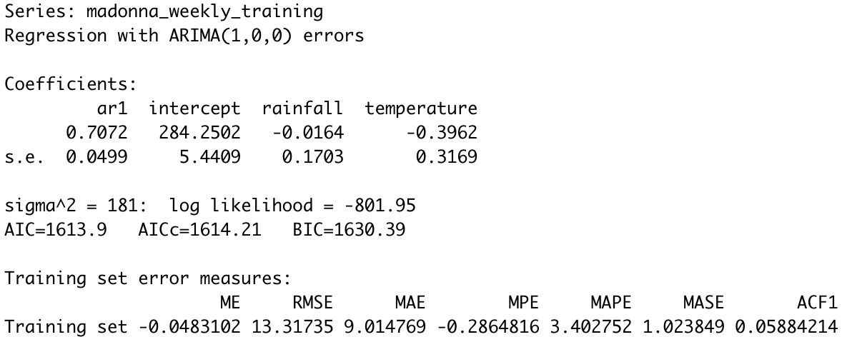
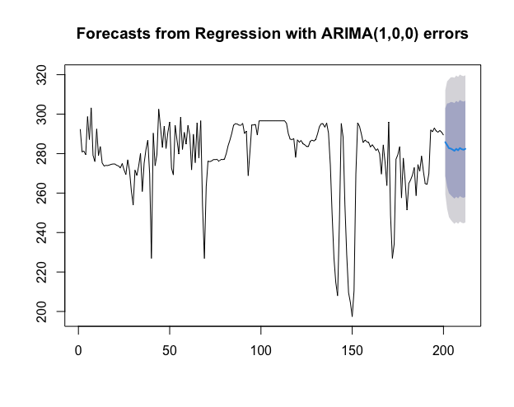

Madonna: Multivariate ARIMA (Weekly)
Notes:
Kelsie

Slide 21



Observations for Weekly ARIMA
Multivariate ARIMA had a better RMSE in the training set compared to Univariate ARIMA, but they are extremely similar
The univariate ARIMA model had a better RMSE for out of sample data
Notes:
Abhay
Similar to the daily observations, the multivariate ARIMA had a better RMSE in the training set, but both were very similar. The univariate ARIMA had a better RMSE for the out of sample data
Found that the weekly aggregation has better RMSEs

Slide 22
5.
Method, Results, & Out of Sample Analysis
Long Short-Term Memory (LSTM)
Notes:
Iustin

Slide 23
What is LSTM?
LSTM is a type of recurrent neural network that is widely used for time series forecasting
LSTM network helps to overcome gradient problems
Makes it possible to capture long-term dependencies
Ability to recognize patterns over the length of the series
Notes:
Iustin

Slide 24
Madonna: LSTM
Illustrated on Madonna water spring with daily data
Steps:
Added delta value equal to the absolute minimum value encountered in the target dataset to avoid negative square roots
Data was normalized by centering, scaling, and removing outliers
Save transformation specification to reinvert predicted values and compare
Notes:
Iustin

Slide 25
Model Specification
Batch size of 30 days, which must be divisible with our desired test length of 90 days while maintaining suggested ratio
Weekly models have been adapted to batch size of 4 and test length of 12 weeks
Dependent variable: Flow Rate
Feature: 90-day lag value of Flow Rate
Time steps: 1
LSTM layer: 50 units (neurons)
Dense layer – connects the neurons of each layer to the next
1 unit
90 epochs – equal to the length of our testing set
Loss function: mean squared error
Optimizer: adam
Notes:
Iustin

Slide 26
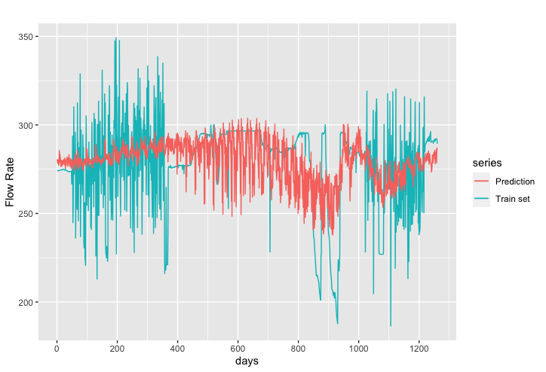
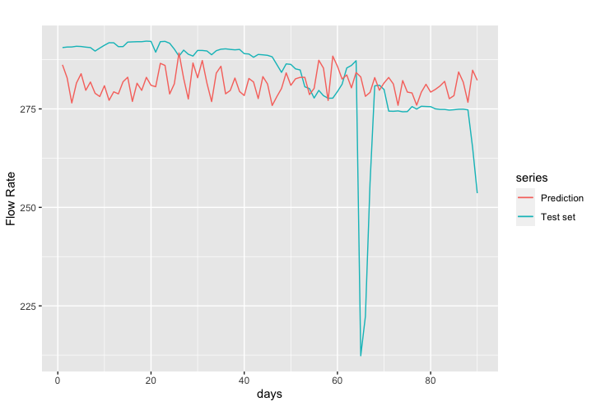


Madonna LSTM Results (Daily)
Training
Testing
Notes:
Iustin

Slide 27
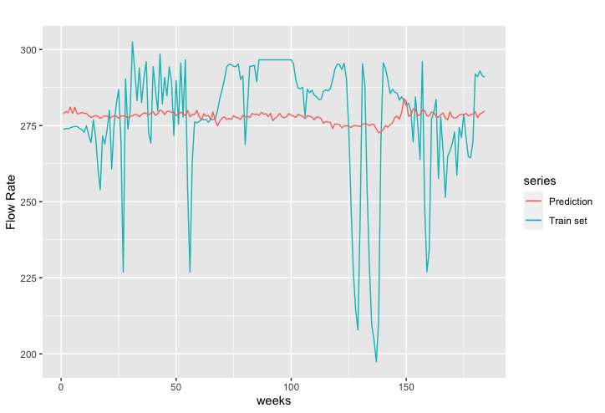
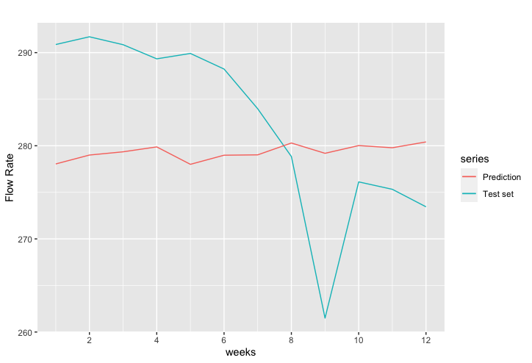


Madonna LSTM Results (Weekly)
Training
Testing
Notes:
Iustin

Slide 28
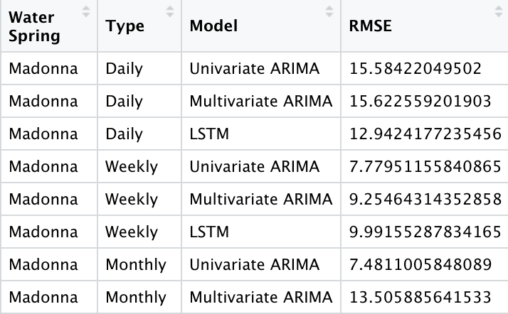
Summary Testing Results
Notes:
Iustin

Slide 29
6.
Lupa Overview
How do our methods transfer to another water spring?
Notes:
Iustin

Slide 30
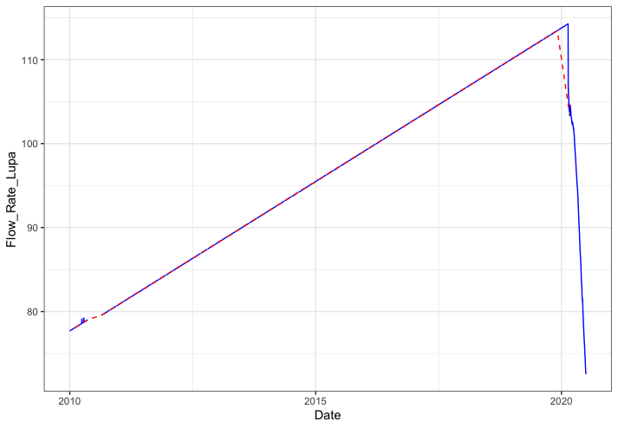
Lupa Flow Rate
Notes:
Iustin

Slide 31
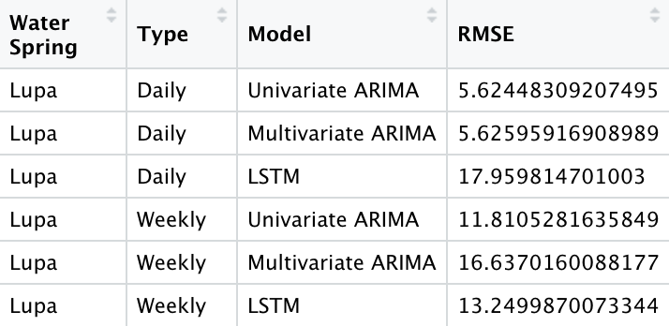
Lupa Flow Rate
Notes:
Iustin

Slide 32
7.
Conclusions
Do these methods work?
Notes:
Dhruvi

Slide 33
Conclusions
Long Short Term Memory (LSTM) method had the best performance
Performed significantly better than ARIMA
Provided better results in daily data than ARIMA
Weekly aggregation provided the best results out of the 3
Univariate ARIMA was more efficient for weekly data
Notes:
Dhruvi
Long Short Term Memory also known as LSTM method had the best performance. It performed significantly better and provided better results in daily data than ARIMA. The weekly aggregation provided the best results out of the three and univariate ARIMA was more efficient for weekly data. LSTM provided better results in daily data because Neural Networks typically tend to scale better with a larger amount of data.

Slide 34
Next Steps & Recommendations
LSTM seems to be a better model on this type of data than ARIMA modeling
Enhance LSTM models through hyperparameter tuning
Expand by creating an LSTM model for Amiata and each different type of waterbody
Find a more compatible external source that can help provide more accurate flowrate forecasting using temperature data
Notes:
Dhruvi
LSTM seems to be a better model on this type of data than ARIMA modeling. For our next steps, we would want to enhance LSTM models through hyperparameter tuning, expand by creating on LSTM model for Amiata and each different type of waterbody. Also, it would be a good idea to find a more compatible external source that can help provide more accurate flow rate forecasting using temperature data.

Slide 35
Thanks!
Any questions?
Notes:
Dhruvi

